Slide 1
Regression Analysis

Slide 2
Topics
Regression Analysis
Simple Linear Regression
Residual Analysis and Regression Assumptions
Multiple Linear Regression
Building Good Regression Models
Regression with Categorical Independent Variables
Regression Models with Nonlinear Terms

Slide 3
Regression Analysis
Regression analysis is a tool for building statistical models that characterize relationships among a dependent variable and one or more independent variables, all of which are numerical.
Simple linear regression involves a single independent variable.
Multiple regression involves two or more independent variables.

Slide 4
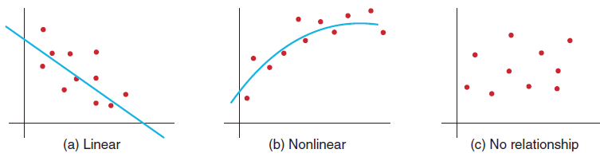
Simple Linear Regression
Finds a linear relationship between:
- one independent variable X and
- one dependent variable Y
First prepare a scatter plot to verify the data has a linear trend.
Use alternative approaches if the data is not linear.

Slide 5
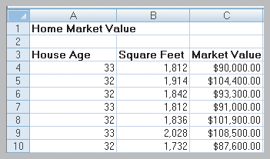
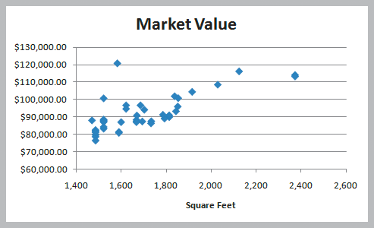
Simple Linear Regression
Example 9.1
Home Market Value Data
Size of a house is typically related to its market value.
X = square footage
Y = market value ($)
The scatter plot of the full data set (42 homes) indicates a linear trend.

Slide 6
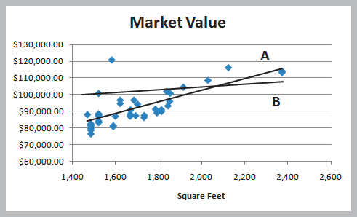
Simple Linear Regression
Finding the Best-Fitting Regression Line
Two possible lines are shown below.
Line A is clearly a better fit to the data.
We want to determine the best regression line.
Y = b₀ + b₁X
where
b₀ is the intercept
b₁ is the slope
^

Slide 7
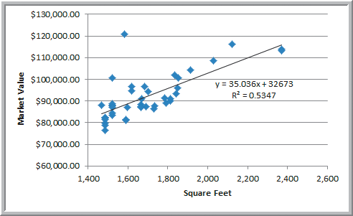
Simple Linear Regression
Example 9.2
Using Excel to Find the Best Regression Line
Market value = 32673 + 35.036(square feet)
The regression model explains variation in market value due to size of the home.
It provides better estimates of market value than simply using the average.

Slide 8
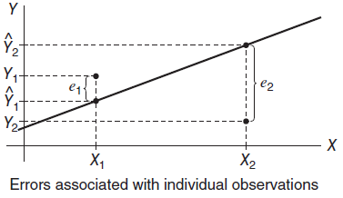
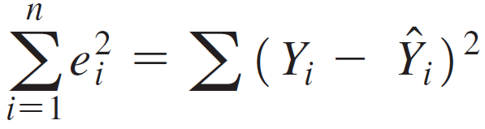
Simple Linear Regression
Least-Squares Regression
Using calculus we can solve for the slope and intercept of the least-squares regression line.
Regression analysis finds
the equation of the best-fitting line that minimizes
the sum of the squares of the observed errors (residuals).
Figure 9.6

Slide 9
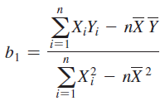

Simple Linear Regression
Least-Squares Regression Equations
Slope
Intercept
Predict Y for specified X values: Y = b₀ + b₁X

Slide 10
Simple Linear Regression
Regression Analysis of Variance
ANOVA conducts an F-test to determine whether variation in Y is due to varying levels of X.
ANOVA is used to test for significance of regression:
H₀: population slope coefficient = 0
H₁: population slope coefficient ≠ 0
Rejecting H₀ indicates that X explains variation in Y.

Slide 11
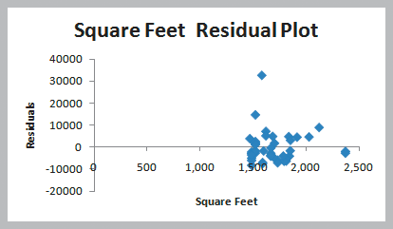
Residual Analysis and Regression Assumptions
Residual Analysis
Residuals are observed errors.
Residual = Actual Y value − Predicted Y value
Standard residual = residual / standard deviation
Rule of thumb: Standard residuals outside of ±2 or ±3 are potential outliers.

Slide 12
Residual Analysis and Regression Assumptions
Checking Assumptions
Linearity
- examine scatter diagram (should appear linear)
- examine residual plot (should appear random)
Normality of Errors
- view a histogram of standard residuals
- regression is robust to departures from normality
Homoscedasticity
- variation about the regression line is constant
Independence of Errors
- successive observations should not be related

Slide 13
Residual Analysis and Regression Assumptions
Example 9.9 Checking Regression Assumptions for the Home Market Value Data
Linearity - linear trend in scatterplot
- no pattern in residual plot

Slide 14
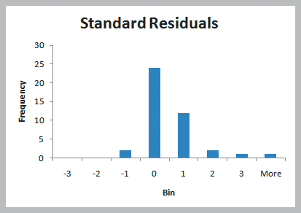
Residual Analysis and Regression Assumptions
Example 9.9 (continued) Checking Regression Assumptions for the Home Market Value Data
Normality of Errors – residual histogram appears slightly skewed but is not a serious departure

Slide 15
Residual Analysis and Regression Assumptions
Example 9.9 (continued) Checking Regression Assumptions for the Home Market Value Data
Homoscedasticity – residual plot shows no serious difference in the spread of the data for different X values.

Slide 16
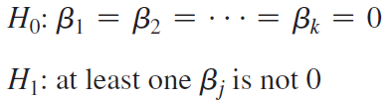
Multiple Linear Regression
Multiple Regression has more than one independent variable.
The multiple linear regression equation is:
The ANOVA test for significance of the entire model is:
One can also test for significance of individual regression coefficients.

Slide 17
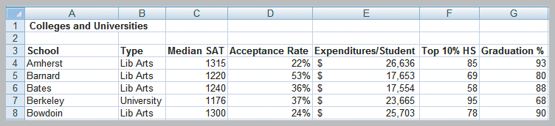
Multiple Linear Regression
Example 9.10 Interpreting Regression Results for the Colleges and Universities Data
Colleges try to predict student graduation rates using a variety of characteristics, such as:
1. Median SAT 3. Acceptance rate
2. Expenditures/student 4. Top 10% of HS class
Y

Slide 18
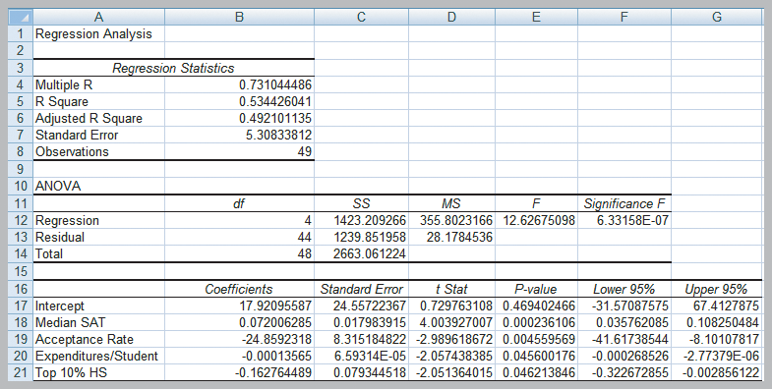
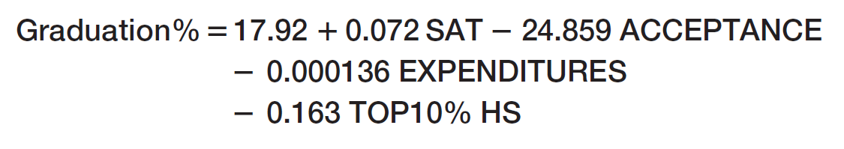
Multiple Linear Regression
Example 9.10 (continued) Interpreting Regression Results for the Colleges and Universities Data

Slide 19
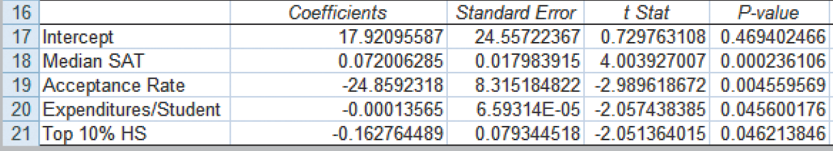
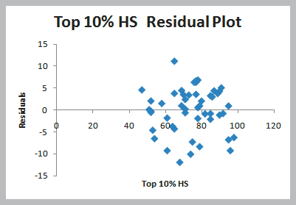
Multiple Linear Regression
Example 9.10 (continued) Interpreting Regression Results for the Colleges and Universities Data
All of the slope coefficient p-values are < 0.05.
From Figure 9.13
The residual plots (only one shown here) show random patterns about 0.
Normal probability plots (not shown) also validate assumptions.
Figure 9.14

Slide 20
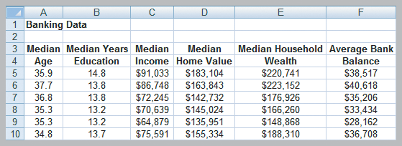
Building Good Regression Models
All of the independent variables in a linear regression model are not always significant.
We will learn how to build good regression models that include the “best” set of variables.
Banking Data includes demographic information on customers in the bank’s current market.
Y

Slide 21
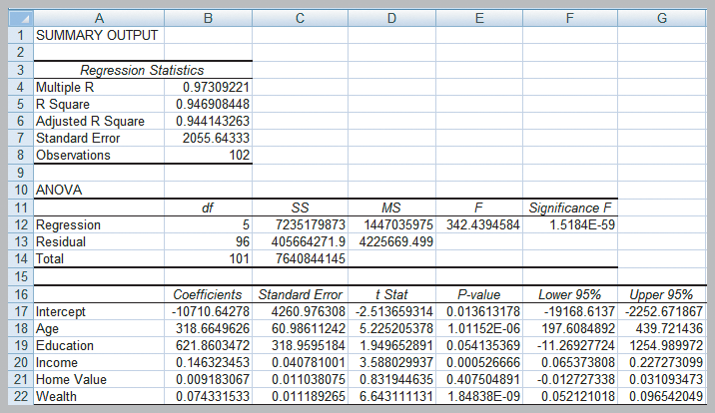
Building Good Regression Models
Predicting Average Bank Balance using Regression
Home Value and Education are not significant.

Slide 22
Building Good Regression Models
Systematic Approach to Building Good Multiple Regression Models
1. Construct a model with all available independent
variables and check for significance of each.
2. Identify the largest p-value that is greater than α.
3. Remove that variable and evaluate adjusted R².
4. Continue until all variables are significant.
→ Find the model with the highest adjusted R².
(Do not use unadjusted R² since it always
increases when variables are added.)

Slide 23
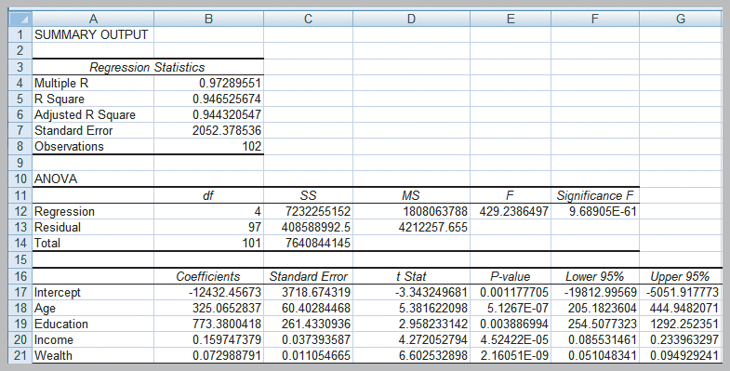
Building Good Regression Models
Example 9.11
Identifying the Best Regression Model
Bank regression after removing Home Value
Adjusted R² improves slightly.
All X variables are significant.

Slide 24
Building Good Regression Models
Multicollinearity
- occurs when there are strong correlations among
the independent variables
- makes it difficult to isolate the effects of
independent variables
- signs of slope coefficients may be opposite of the
true value and p-values can be inflated
Correlations exceeding ±0.7 are an indication that multicollinearity might exist.
Variance Inflation Factors are a better indicator.
Parsimony is an age-old principle that applies here.

Slide 25
Building Good Regression Models
Example 9.12
Identifying Potential Multicollinearity
Colleges and Universities (full model)
Full model
Adjusted R² = 0.4921

Slide 26
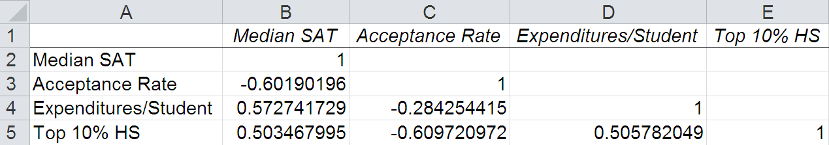
Building Good Regression Models
Example 9.12 (continued)
Identifying Potential Multicollinearity
Correlation Matrix (Colleges and Universities data)
All of the correlations are within ±0.7
Signs of the coefficients are questionable for Expenditures and Top 10%.
From Figure 9.19

Slide 27
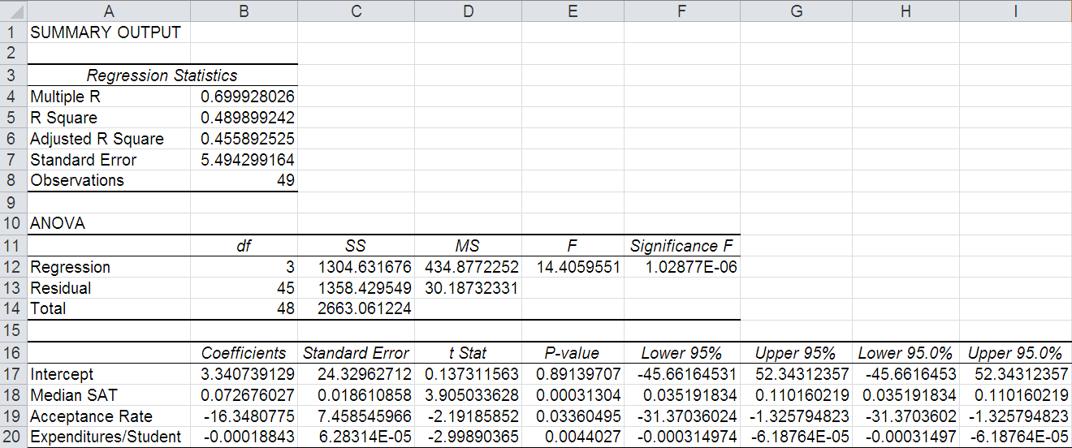
Building Good Regression Models
Example 9.12 (continued)
Identifying Potential Multicollinearity
Colleges and Universities (reduced model)
Dropping Top 10%
Adjusted R² drops to 0.4559

Slide 28
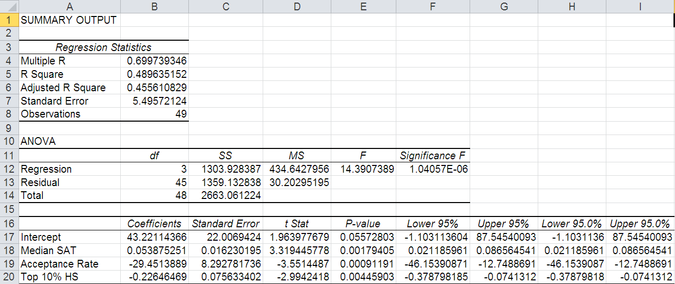
Building Good Regression Models
Example 9.12 (continued)
Identifying Potential Multicollinearity
Colleges and Universities (reduced model)
Dropping Expenditures
Adjusted R² drops to 0.4556

Slide 29
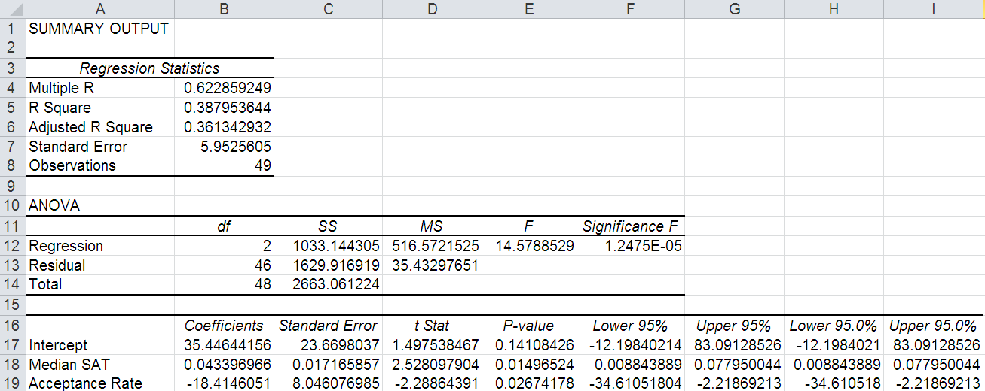
Building Good Regression Models
Example 9.12 (continued)
Identifying Potential Multicollinearity
Colleges and Universities (reduced model)
Dropping Expenditures and Top 10%
Adjusted R² drops to 0.3613
Which of the 4 models would you choose?

Slide 30
Building Good Regression Models
Example 9.12 (continued)
Banking Data (full model)
Full Model
Adjusted R² = 0.9441
Education and Home Value
are not significant.

Slide 31
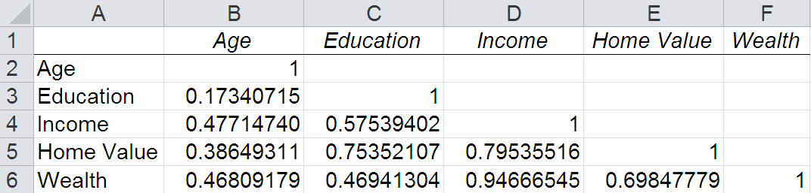
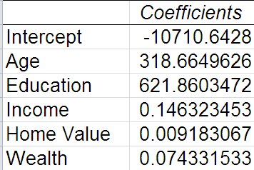
Building Good Regression Models
Example 9.12 (continued)
Identifying Potential Multicollinearity
Correlation matrix for the Banking data
Some of the correlations exceed 0.7 for Home Value and Wealth.
Signs of the coefficients for predicting bank balance are as expected (positive).

Slide 32
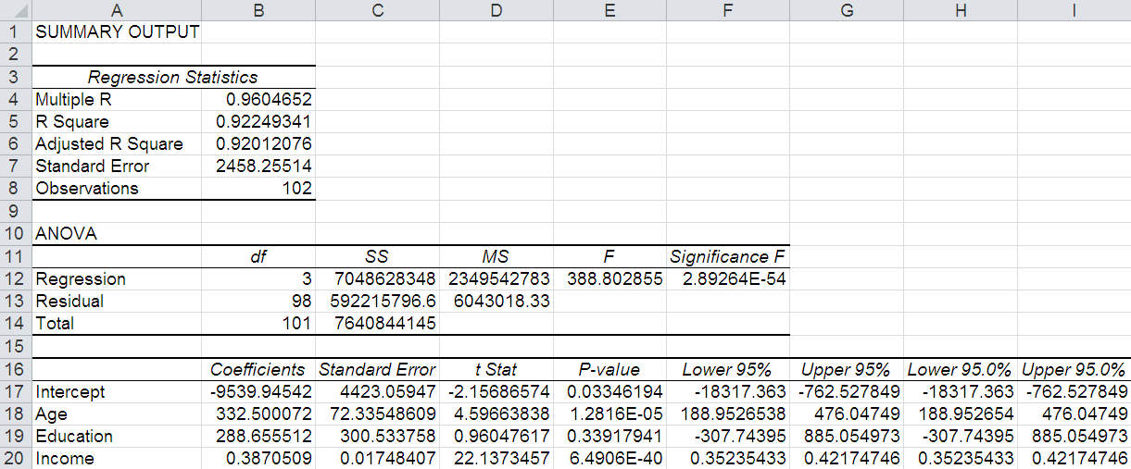
Building Good Regression Models
Example 9.12 (continued)
Banking Data (reduced model)
Dropping Wealth and Home Value
Adjusted R² drops to 0.9201
Education is not significant.

Slide 33
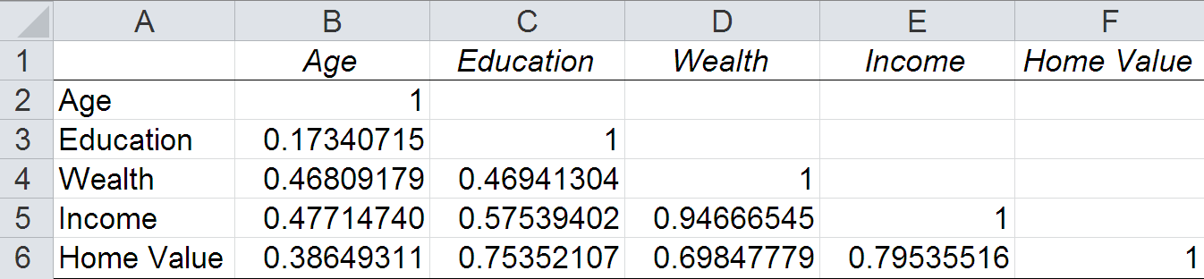
Building Good Regression Models
Example 9.12 (continued)
Identifying Potential Multicollinearity
Re-ordered Correlation matrix for Banking data
By re-ordering the variables, we can see the correlations for Age, Education, and Wealth are all within ± 0.7.
Let’s try a reduced model with the Age, Education, and Wealth variables.
From Figure 9.20

Slide 34
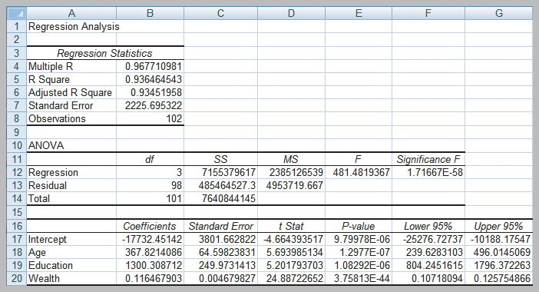
Building Good Regression Models
Example 9.12 (continued)
Banking Data (reduced model) ** best model
Dropping Income and Home Value.
Adjusted R² = 0.9345.
All variables are significant. Multicollinearity is not a problem.
Figure 9.21

Slide 35
Regression with Categorical Variables
Dealing with Categorical Variables
Must be coded numeric using dummy variables.
For variables with 2 categories, code as 0 and 1.
For variables with k ≥ 3 categories, create k−1 binary (0,1) variables.
Interaction Terms
A dependence between two variables is called interaction.
Test for interaction by adding a new term to the model, such as X₃ = X₁X_{2.}

Slide 36
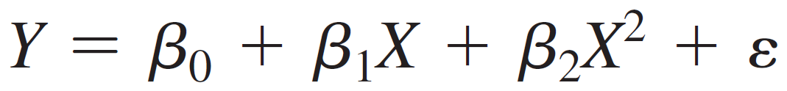
Regression Models with Nonlinear Terms
Curvilinear Regression
Curvilinear models may be appropriate when scatter charts or residual plots show nonlinear relationships.
A second order polynomial might be used
Here β₁ represents the linear effect of X on Y and β₂ represents the curvilinear effect.
This model is linear in the β parameters so we can use linear regression methods.

Slide 37
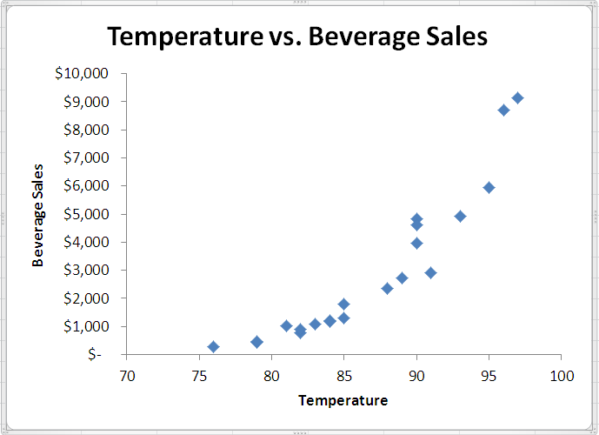
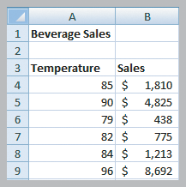
Regression Models with Nonlinear Terms
Example 9.16 Modeling Beverage Sales Using Curvilinear Regression
Sales of cold beverages increase when it is hotter outside.
Figure 9.30

Slide 38
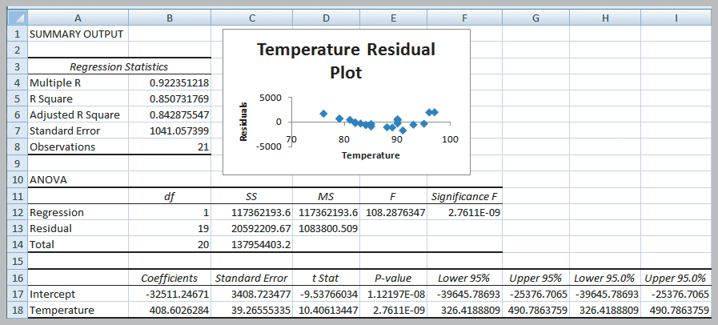
Regression Models with Nonlinear Terms
Example 9.16 (continued) Modeling Beverage Sales Using Curvilinear Regression
U-shape residual plot

Slide 39
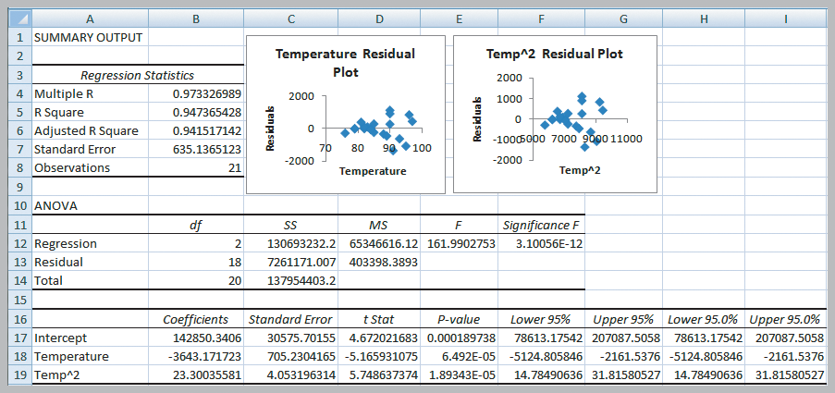
Regression Models with Nonlinear Terms
Example 9.16 (continued) Modeling Beverage Sales Using Curvilinear Regression
Residual pattern is more random
Sales = 142,850
−3643(temperature)
+ 23.3(temperature)²

Slide 40
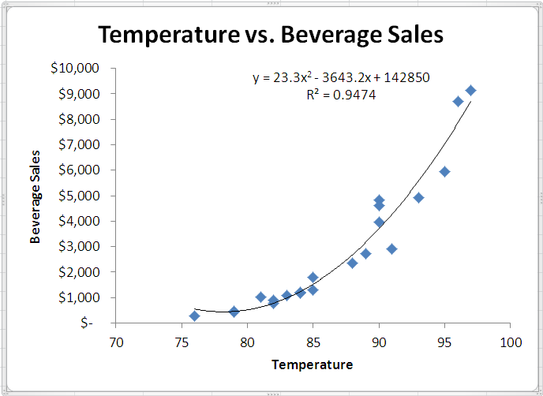
Regression Models with Nonlinear Terms
Example 9.16 (continued) Modeling Beverage Sales Using Curvilinear Regression
Second Order Polynomial Trendline

